Slide 1
6.852: Distributed Algorithms Fall, 2015
Lecture 13

Slide 2
Last time
Synchronizers, which allow us to run synchronous distributed network algorithms in an asynchronous network, with comparatively low costs in time and communication.
Applications: BFS, Shortest Paths,…
U₁
U₂
FE₁
FE₂
OK
GO
OK
GO
SafeSynch
Synchronizers achieve local synchronization.
Now we show that achieving stronger, global synchronization must take considerable more time.

Slide 3
Lower Bound on Time for Synchronization
flash₂
flash₁
flash_{n}
A

Slide 4


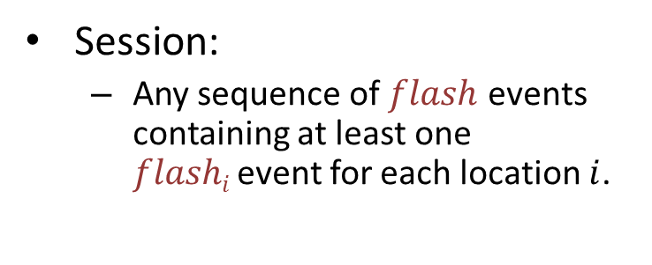
$k$-Session Problem
flash₂
Session:
Any sequence of $flash$ events containing at least one $flashi$event for each location $i$.
flash₁
flash_{n}
$k$-Session problem:
Perform at least $k$separate sessions (in every fair execution), and eventually halt.

Slide 5

Asynchronous lower bound
Consider a distributed algorithm $A$ that solves the $k$-session problem.
Time measure:
Timed execution: Fair execution with times labeling events, subject to upper bounds $d$ and $l$.
$T(α)$ = time of last flash in timed execution α.
$T(A)$ = supremum, over all timed executions α, of $T().$
flash₂
flash₁
flash_{n}
A
Notes:
We’re going to ignore the l terms in the lower bound theorem and proof.

Slide 6
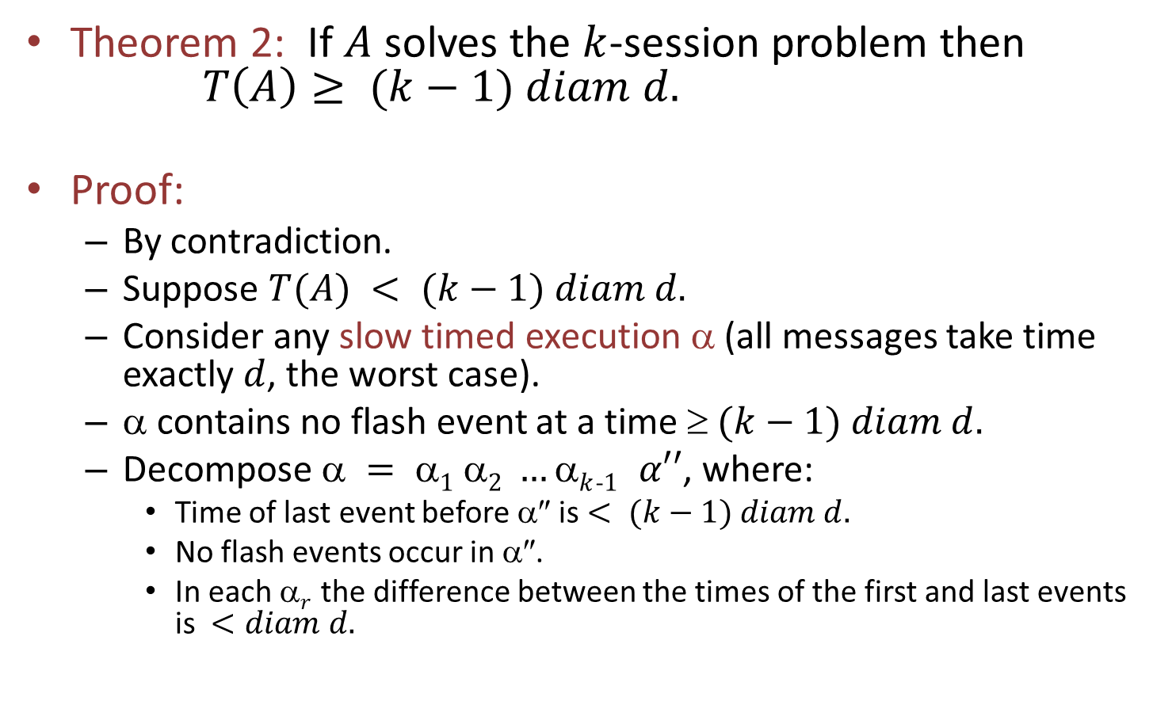
Lower bound
Theorem 2: If $A$ solves the $k$-session problem then $T\left(A\right)≥ (k−1) diam d.$
Proof:
By contradiction.
Suppose $T(A) < (k−1) diam d.$
Consider any slow timed execution α (all messages take time exactly $d$, the worst case).
α contains no flash event at a time $ (k−1) diam d.$
Decompose $ = 1 2 …k$₋$1 α′′$, where:
Time of last event before α″ is $< (k−1) diam d.$
No flash events occur in α″.
In each α$r$ the difference between the times of the first and last events is $<diam d.$

Slide 7
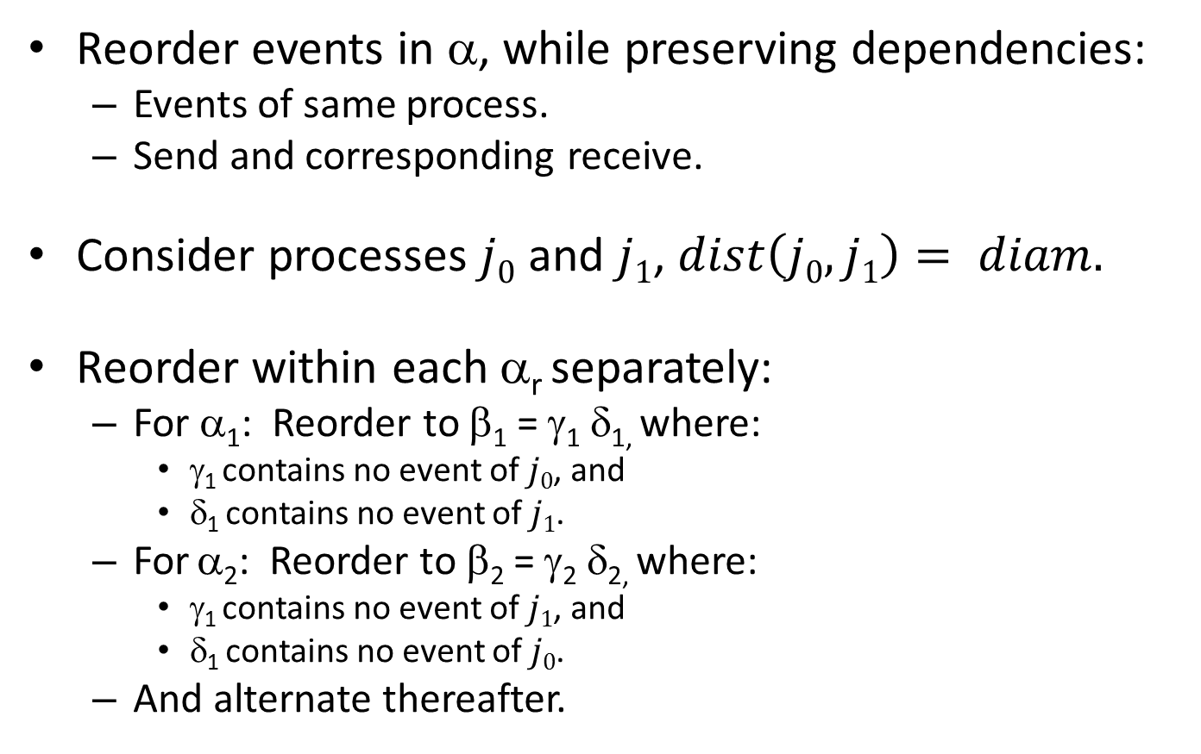
Lower bound
Reorder events in α, while preserving dependencies:
Events of same process.
Send and corresponding receive.
Consider processes $j0$ and $j1$, $dist\left(j0,j1\right)= diam.$
Reorder within each α_{r} separately:
For α₁: Reorder to β₁ = γ₁ δ_{1,} where:
γ₁ contains no event of $j0$, and
δ₁ contains no event of $j1$.
For α₂: Reorder to β₂ = γ₂ δ_{2,} where:
γ₁ contains no event of $j1$, and
δ₁ contains no event of $j0$.
And alternate thereafter.

Slide 8
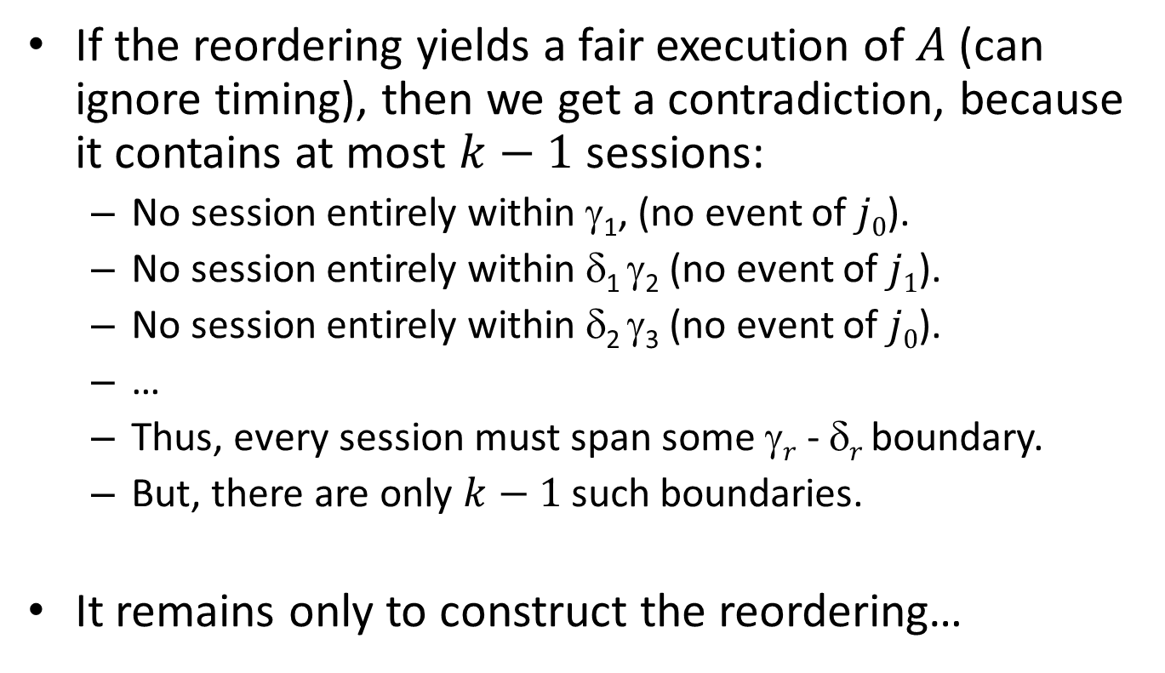
Lower bound, cont’d
If the reordering yields a fair execution of $A$(can ignore timing), then we get a contradiction, because it contains at most $k−1$ sessions:
No session entirely within γ₁, (no event of $j0$).
No session entirely within δ₁ γ₂ (no event of $j1$).
No session entirely within δ₂ γ₃ (no event of $j0$).
…
Thus, every session must span some γ$r$ - δ$r$ boundary.
But, there are only $k−1$ such boundaries.
It remains only to construct the reordering…
Notes:
Note: The contradiction doesn’t mention timing. It’s just that we get too few sessions.

Slide 9
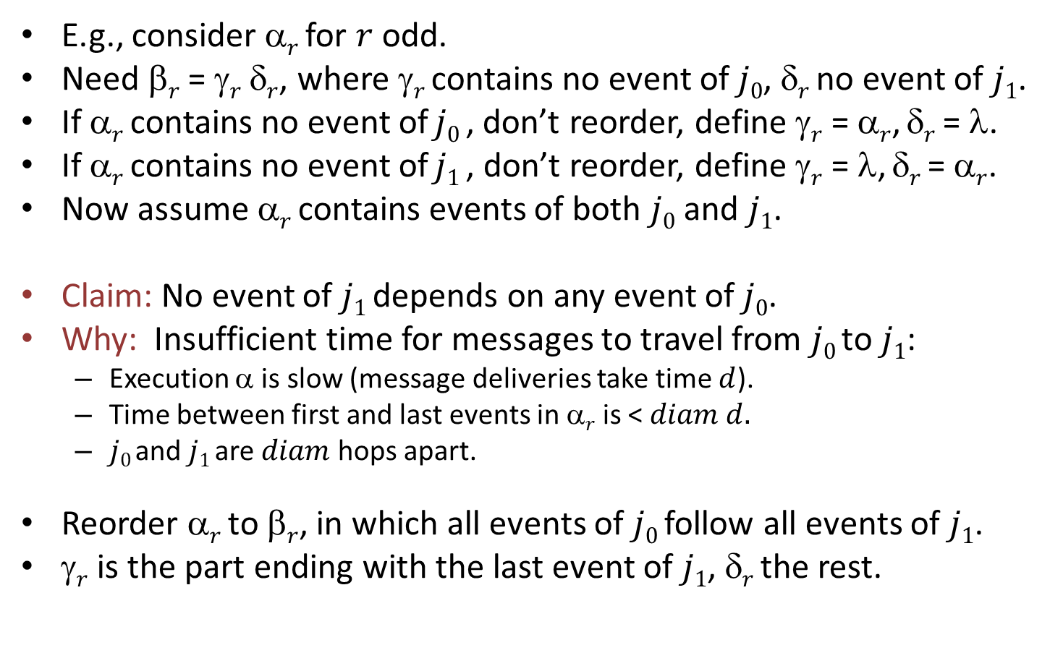
Constructing the reordering
E.g., consider α$r$ for $r$ odd.
Need β$r$ = γ$r$ δ$r$, where γ$r$ contains no event of $j0$, δ$r$ no event of $j1$.
If α$r$ contains no event of $j0$ , don’t reorder, define γ$r$ = α$r$, δ$r$ = λ.
If α$r$ contains no event of $j1$, don’t reorder, define γ$r$ = λ, δ$r$ = α$r$.
Now assume α$r$ contains events of both $j0$ and $j1$.
Claim: No event of $j1$depends on any event of $j0$.
Why: Insufficient time for messages to travel from $j0$ to $j1$:
Execution α is slow (message deliveries take time $d$).
Time between first and last events in α$r$ is < $diam d.$
$j0$ and $j1$ are $diam$ hops apart.
Reorder α$r$ to β$r$, in which all events of $j0$follow all events of $j1$.
γ$r$ is the part ending with the last event of $j1$, δ$r$ the rest.

Slide 10
Today’s plan
Logical time
Applications of logical time
Weak logical time and vector timestamps
Reading:
Chapter 18
[Lamport 1978] Time, Clocks, and the Ordering of Events in a Distributed System
[Mattern]
Next:
Consistent global snapshots
Stable property detection
Reading: Chapter 19
Notes:
Continuing our study of general techniques for designing algorithms for asynchronous networks.
Synchronizers
Logical time
Global snapshots and stable property detection

Slide 11

Logical Time

Slide 12
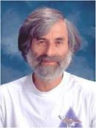
[Lamport] Time, clocks,…
Winner of first Dijkstra Prize, 2000.
“Jim Gray once told me that he heard two different opinions of this paper: that's it trivial and that it's brilliant. I can't argue with the former, and I'm disinclined to argue with the latter.” –Lamport
Notes:
8718 citations as of today.

Slide 13
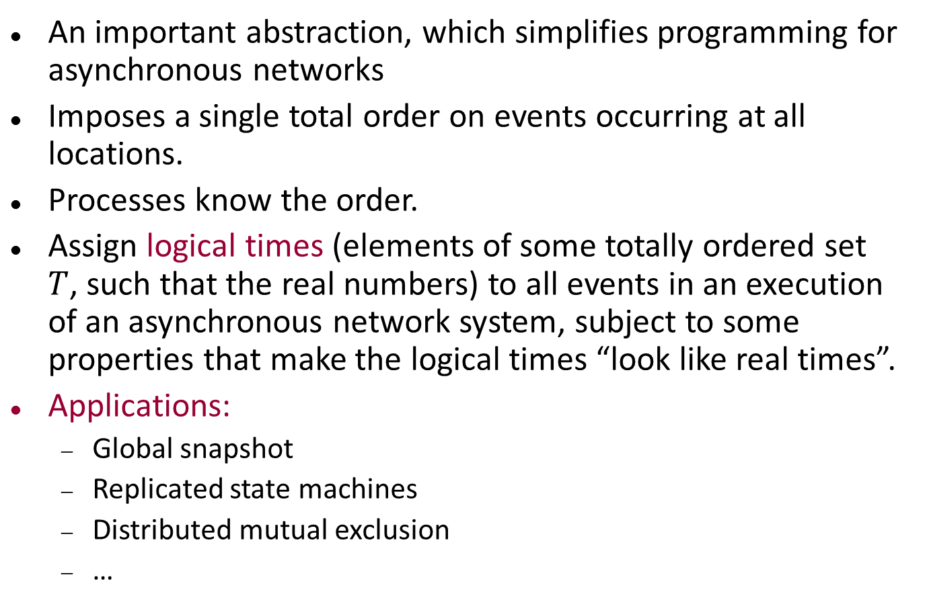
Logical time
An important abstraction, which simplifies programming for asynchronous networks
Imposes a single total order on events occurring at all locations.
Processes know the order.
Assign logical times (elements of some totally ordered set $T$, such that the real numbers) to all events in an execution of an asynchronous network system, subject to some properties that make the logical times “look like real times”.
Applications:
Global snapshot
Replicated state machines
Distributed mutual exclusion
…

Slide 14
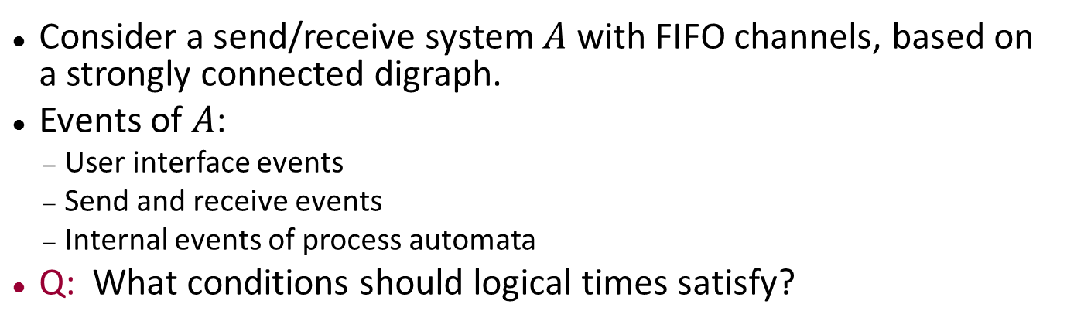
Logical time
user
interface
P₂
P_{n}
P₁
send,
receive
Message system
Consider a send/receive system $A$ with FIFO channels, based on a strongly connected digraph.
Events of $A$:
User interface events
Send and receive events
Internal events of process automata
Q: What conditions should logical times satisfy?

Slide 15
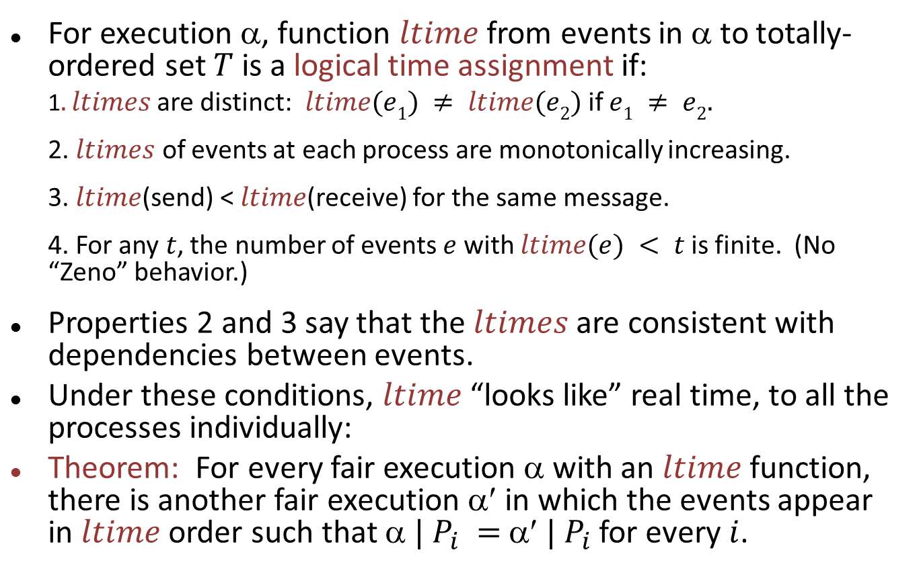
Logical time
For execution α, function $ltime$ from events in α to totally-ordered set $T$ is a logical time assignment if:
1$. ltimes$are distinct: $ltime(e1) ≠ ltime(e2)$if $e1 ≠ e2.$
2. $ltimes$ of events at each process are monotonically increasing.
3. $ltime$(send) < $ltime$(receive) for the same message.
4. For any $t$, the number of events $e$ with $ltime(e) < t$is finite. (No “Zeno” behavior.)
Properties 2 and 3 say that the $ltimes$are consistent with dependencies between events.
Under these conditions, $ltime$ “looks like” real time, to all the processes individually:
Theorem: For every fair execution α with an $ltime$ function, there is another fair execution α′ in which the events appear in $ltime$ order such that $ | P_{i} =$ $ | P_{i}$for every $i$.
Notes:
Again we see causality ideas.
Again we see the idea that the execution looks the same to individual processes, but not necessarily to everyone together.

Slide 16
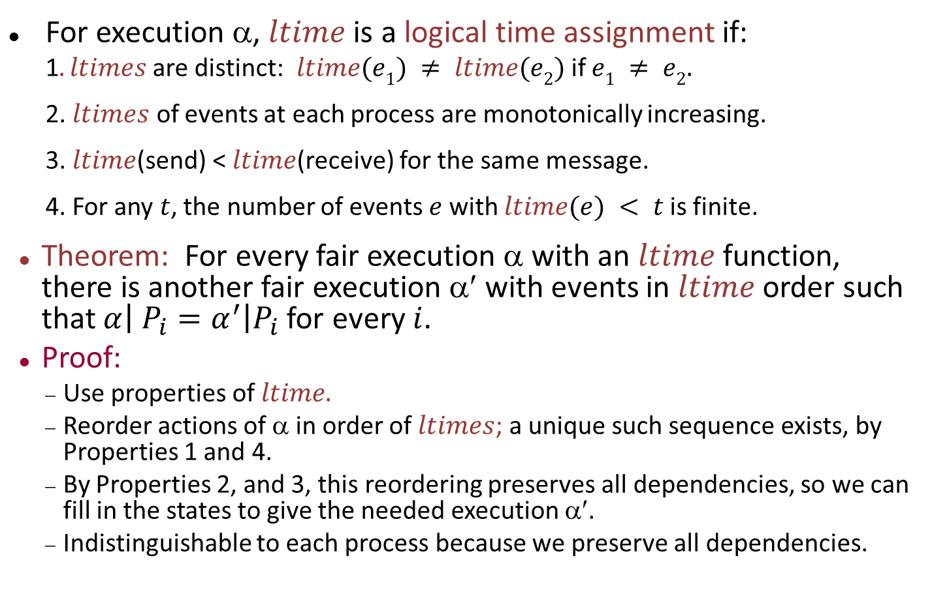
Logical time
For execution α, $ltime$ is a logical time assignment if:
1$. ltimes$are distinct: $ltime(e1) ≠ ltime(e2)$if $e1 ≠ e2.$
2. $ltimes$ of events at each process are monotonically increasing.
3. $ltime$(send) < $ltime$(receive) for the same message.
4. For any $t$, the number of events $e$ with $ltime(e) < t$is finite.
Theorem: For every fair execution α with an $ltime$ function, there is another fair execution α′ with events in $ltime$ order such that $α\left| P_{i}=α^{′}\right|P_{i}$for every $i$.
Proof:
Use properties of $ltime.$
Reorder actions of α in order of $ltimes$; a unique such sequence exists, by Properties 1 and 4.
By Properties 2, and 3, this reordering preserves all dependencies, so we can fill in the states to give the needed execution α′.
Indistinguishable to each process because we preserve all dependencies.

Slide 17
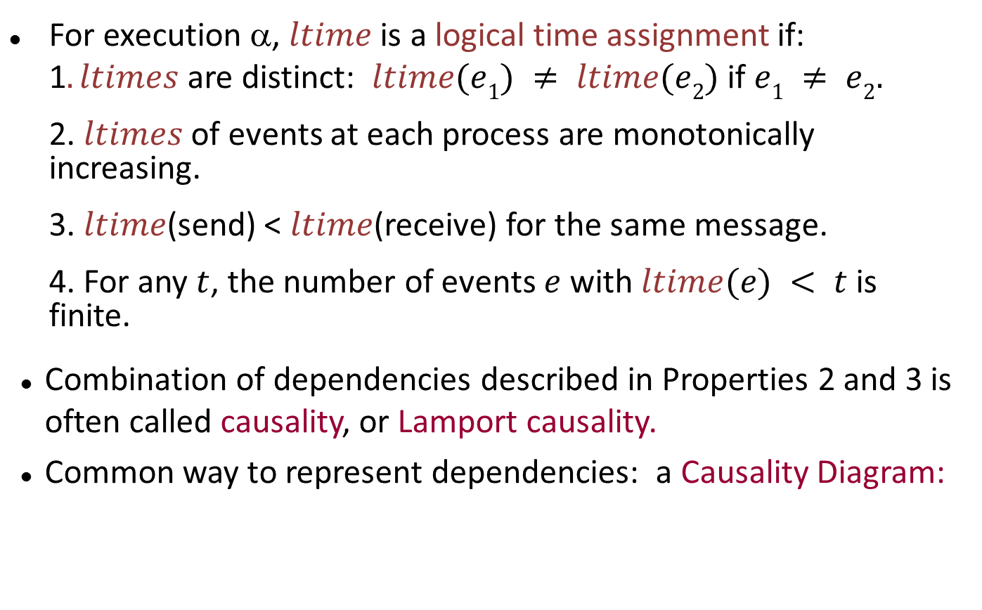
Logical time
For execution α, $ltime$ is a logical time assignment if:
1$. ltimes$are distinct: $ltime(e1) ≠ ltime(e2)$if $e1 ≠ e2.$
2. $ltimes$ of events at each process are monotonically increasing.
3. $ltime$(send) < $ltime$(receive) for the same message.
4. For any $t$, the number of events $e$ with $ltime(e) < t$is finite.
Combination of dependencies described in Properties 2 and 3 is often called causality, or Lamport causality.
Common way to represent dependencies: a Causality Diagram:

Slide 18
Logical time
3
2
6
1
7
9
8
10
11
4
5
12
Notes:
Might also add dots for internal process events and user interface events.
Logical time assignment: The numbers above.

Slide 19
Logical time
3
1
2
2
3
6
4
1
5
7
6
9
7
8
8
9
10
11
10
4
5
11
12
12
Notes:
The numbers represent logical times assigned to events.
Now we reorder the events in order of logical times.
Preserves all dependencies (causality), so we get another execution that looks the same to all processes, and in which events happen in ltime order.

Slide 20
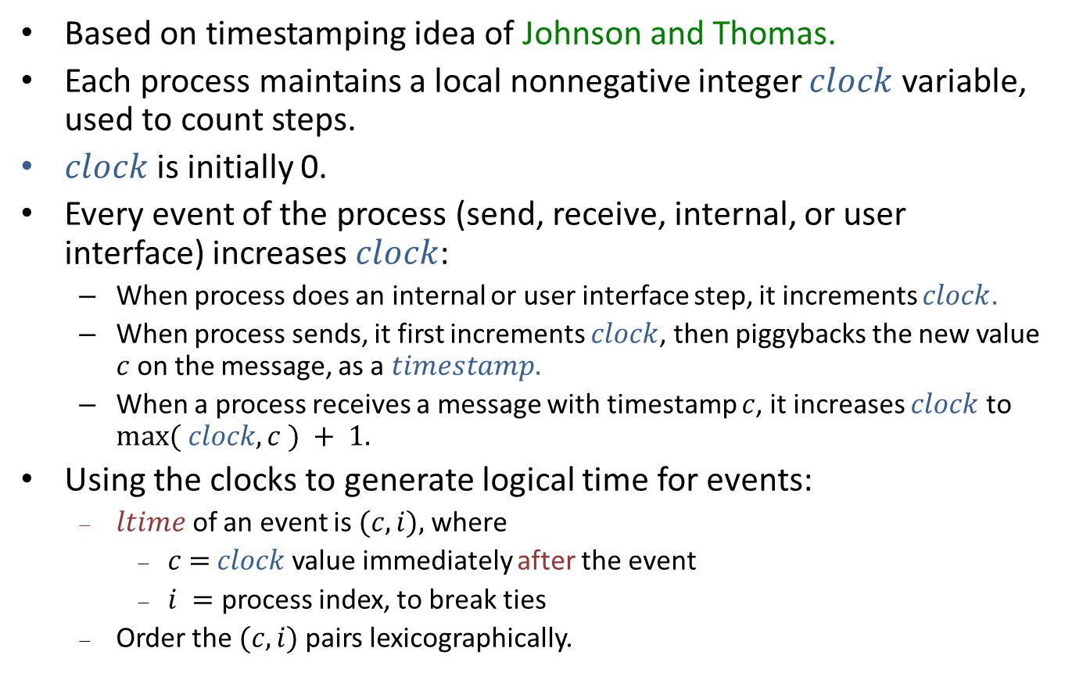
Lamport’s algorithm for generating logical times
Based on timestamping idea of Johnson and Thomas.
Each process maintains a local nonnegative integer $clock$ variable, used to count steps.
$clock$ is initially 0.
Every event of the process (send, receive, internal, or user interface) increases $clock$:
When process does an internal or user interface step, it increments $clock$.
When process sends, it first increments $clock$, then piggybacks the new value $c$ on the message, as a $timestamp.$
When a process receives a message with timestamp $c$, it increases $clock$ to $max⁡( clock, c ) + 1.$
Using the clocks to generate logical time for events:
$ltime$ of an event is $(c,i),$where
$c$ $=$ $clock$value immediately after the event
$i =$ process index, to break ties
Order the $(c,i)$pairs lexicographically.
Notes:
This is a modification to an underlying, running distributed algorithm. Each process does a bit extra, over its normal activities.

Slide 21
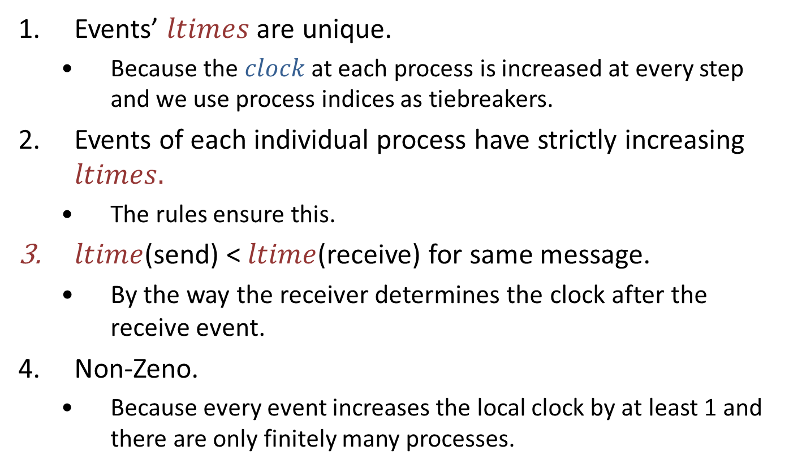
Lamport’s algorithm generates logical times
Events’ $ltimes$ are unique.
Because the $clock$ at each process is increased at every step and we use process indices as tiebreakers.
Events of each individual process have strictly increasing $ltimes.$
The rules ensure this.
$ltime$(send) < $ltime$(receive) for same message.
By the way the receiver determines the clock after the receive event.
Non-Zeno.
Because every event increases the local clock by at least 1 and there are only finitely many processes.

Slide 22
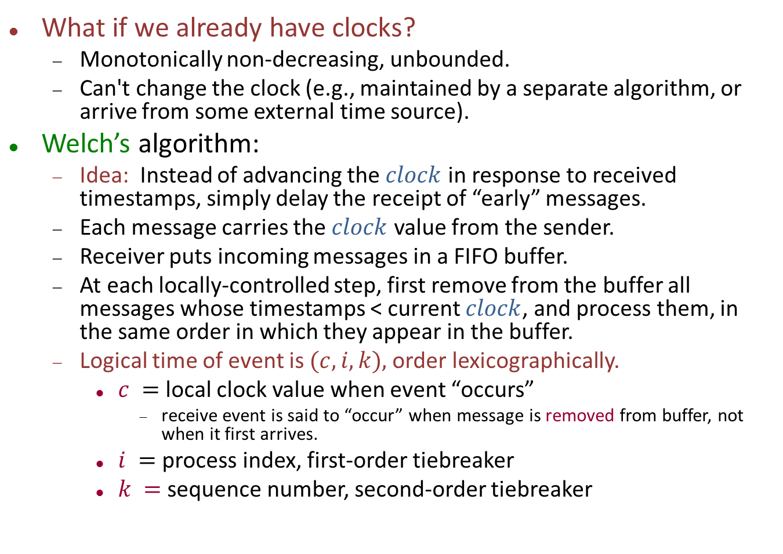
Welch’s algorithm
What if we already have clocks?
Monotonically non-decreasing, unbounded.
Can't change the clock (e.g., maintained by a separate algorithm, or arrive from some external time source).
Welch’s algorithm:
Idea: Instead of advancing the $clock$ in response to received timestamps, simply delay the receipt of “early” messages.
Each message carries the $clock$ value from the sender.
Receiver puts incoming messages in a FIFO buffer.
At each locally-controlled step, first remove from the buffer all messages whose timestamps < current $clock$, and process them, in the same order in which they appear in the buffer.
Logical time of event is $(c,i,k),$order lexicographically.
$c =$ local clock value when event “occurs”
receive event is said to “occur” when message is removed from buffer, not when it first arrives.
$i =$ process index, first-order tiebreaker
$k =$ sequence number, second-order tiebreaker
Notes:
We need a second-order tie-breaker since the process doesn’t control the clock, so several local events could occur while the clock’s value is unchanged.

Slide 23
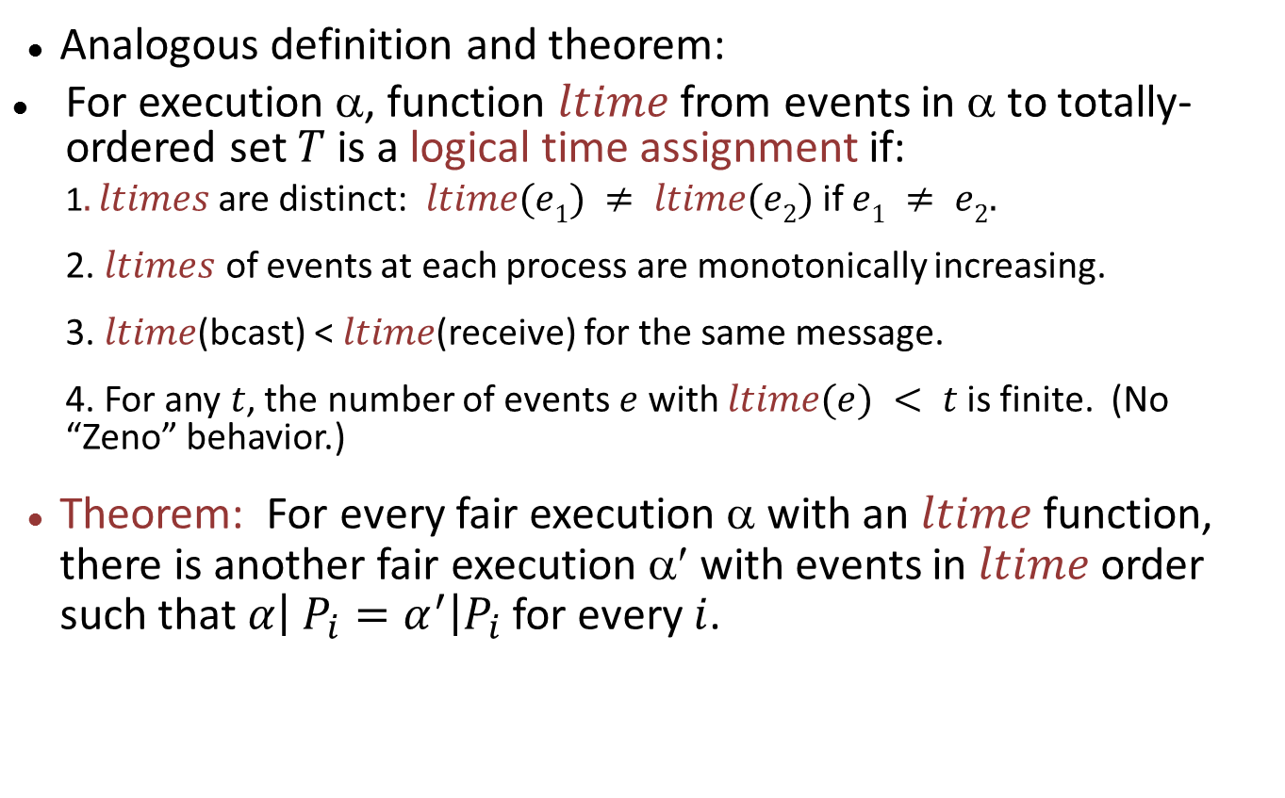
Logical time in broadcast systems
Analogous definition and theorem:
For execution α, function $ltime$ from events in α to totally-ordered set $T$ is a logical time assignment if:
1$. ltimes$are distinct: $ltime(e1) ≠ ltime(e2)$if $e1 ≠ e2.$
2. $ltimes$ of events at each process are monotonically increasing.
3. $ltime$(bcast) < $ltime$(receive) for the same message.
4. For any $t$, the number of events $e$ with $ltime(e) < t$is finite. (No “Zeno” behavior.)
Theorem: For every fair execution α with an $ltime$ function, there is another fair execution α′ with events in $ltime$ order such that $α\left| P_{i}=α^{′}\right|P_{i}$for every $i$.
Notes:
Must remind the students about broadcast systems. A broadcast channel has bcast_i and receive_i,j events. It uses a separate queue for every (i,j) pair. So it preserves the order between each pair of nodes but not the global order of all messages.
Only property 3 changes.

Slide 24
Applications of Logical Time

Slide 25
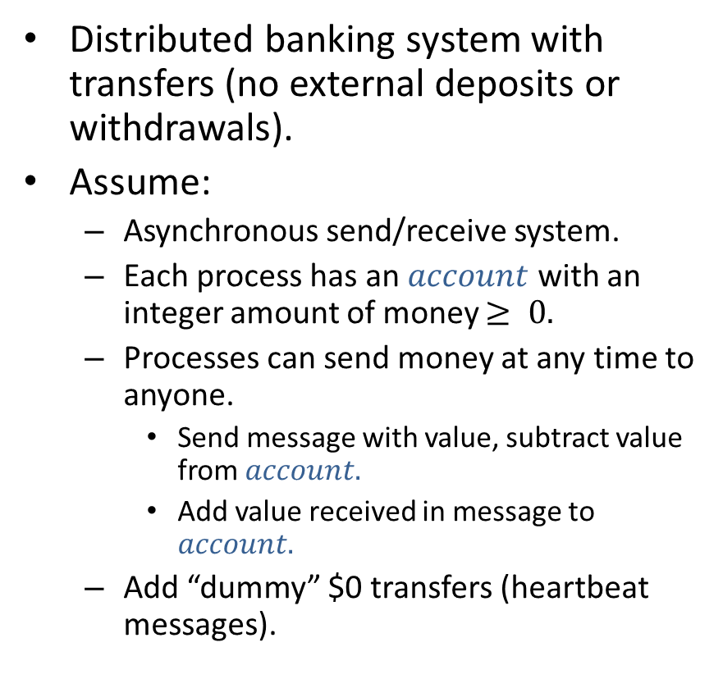
Banking System
Distributed banking system with transfers (no external deposits or withdrawals).
Assume:
Asynchronous send/receive system.
Each process has an $account$ with an integer amount of money $≥ 0.$
Processes can send money at any time to anyone.
Send message with value, subtract value from $account.$
Add value received in message to $account.$
Add “dummy” $0 transfers (heartbeat messages).
$10
$10
$10
$5
$10
$4
$8

Slide 26
Banking System
Algorithm triggered by input signal to one or more processes; processes awaken upon receiving either such a signal or a message from another process.
Require:
Each process should output local balance, so that total of the balances = correct amount of money in the system.
Well-defined because there are no deposits/withdrawals.
Don’t “interfere” with underlying money transfer, just “observe” it.
$10
$10
$10
$5
$10
$4
$8
Notes:
The non-interference requirement is formalized in the book, in terms that say that the new algorithm is a transformed version of the original system, using a particular kind of transformation where each process just monitors the original one and does some additional computation.

Slide 27
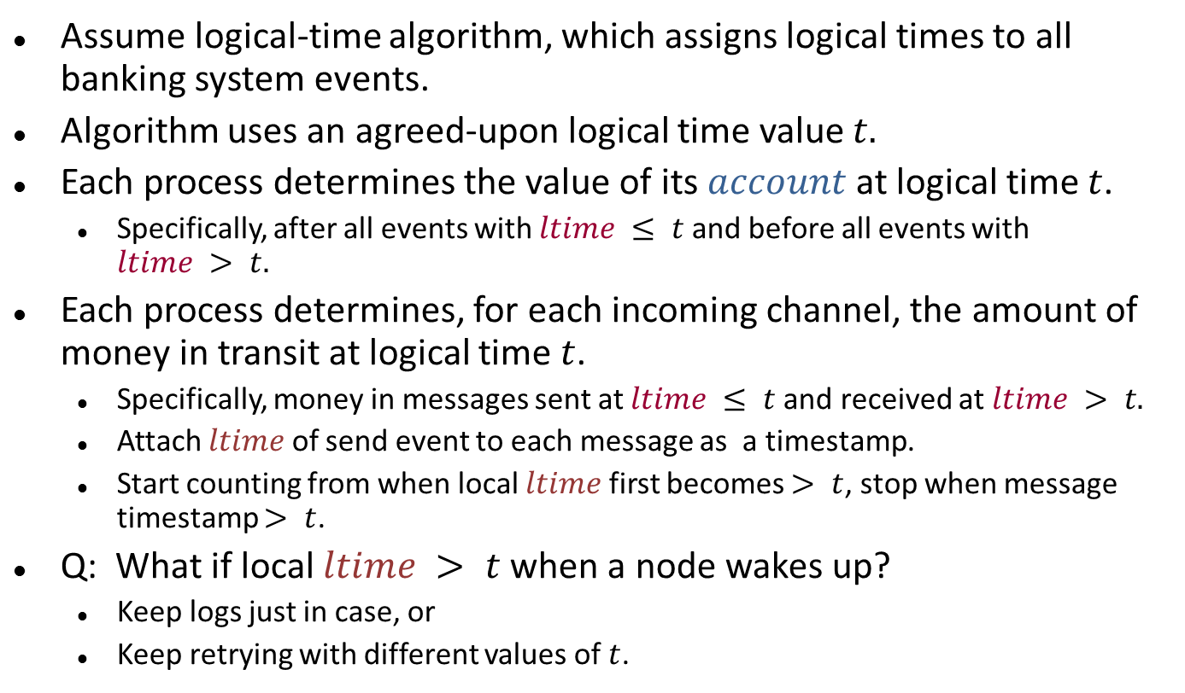
Banking system algorithm
Assume logical-time algorithm, which assigns logical times to all banking system events.
Algorithm uses an agreed-upon logical time value $t.$
Each process determines the value of its $account$ at logical time $t$.
Specifically, after all events with $ltime ≤ t$and before all events with $ltime > t.$
Each process determines, for each incoming channel, the amount of money in transit at logical time $t$.
Specifically, money in messages sent at $ltime ≤ t$and received at $ltime > t.$
Attach $ltime$ of send event to each message as a timestamp.
Start counting from when local $ltime$ first becomes $> t$, stop when message timestamp $> t$.
Q: What if local $ltime > t$ when a node wakes up?
Keep logs just in case, or
Keep retrying with different values of $t$.
Notes:
Some bookkeeping is needed to remember the last state, the one just before ltime strictly exceeds t.

Slide 28
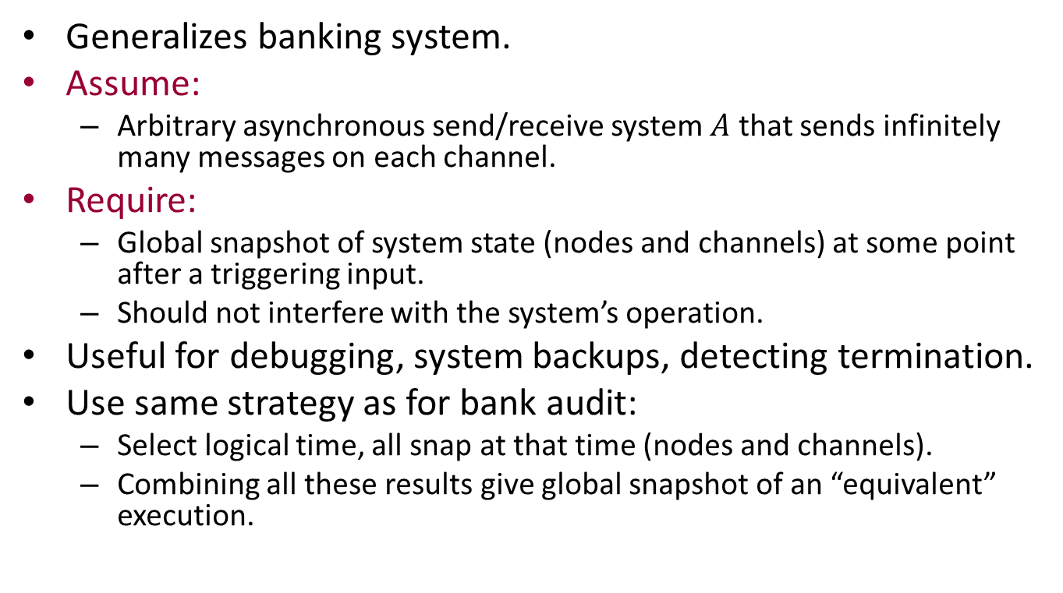
Applications of logical time: Global snapshot
Generalizes banking system.
Assume:
Arbitrary asynchronous send/receive system $A$ that sends infinitely many messages on each channel.
Require:
Global snapshot of system state (nodes and channels) at some point after a triggering input.
Should not interfere with the system’s operation.
Useful for debugging, system backups, detecting termination.
Use same strategy as for bank audit:
Select logical time, all snap at that time (nodes and channels).
Combining all these results give global snapshot of an “equivalent” execution.
Notes:
This should be a coherent global snapshot, as if the system stopped operating at some time.
We will see this idea in more detail next time.

Slide 29
Another application: Replicated State Machines (RSMs)
Notes:
This is what Lamport considered the most important idea in the paper.
Of course, authors don’t always get to decide this.
Most of the citations to the paper are for “Lamport causality”, and the logical time idea.

Slide 30
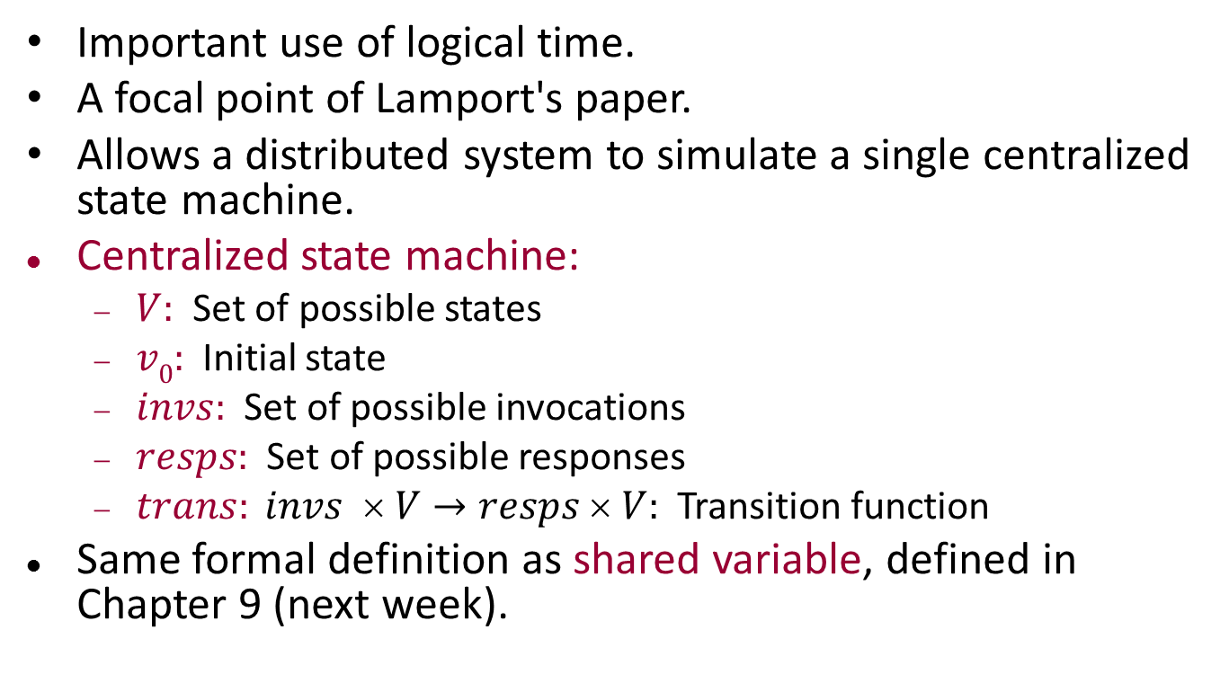
Replicated State Machines (RSMs)
Important use of logical time.
A focal point of Lamport's paper.
Allows a distributed system to simulate a single centralized state machine.
Centralized state machine:
$V:$ Set of possible states
$v0:$Initial state
$invs:$Set of possible invocations
$resps:$Set of possible responses
$trans: invs  V→resps  V:$Transition function
Same formal definition as shared variable, defined in Chapter 9 (next week).
Notes:
In fact, Lamport said this was the main point of the paper.

Slide 31
Replicated State Machines
Users of distributed system submit invocations, get responses in well-formed manner (blocking invocations).
Want system to look like “atomic” version of the centralized state machine (defined in Chapter 13).
Allows possible delays before and after actually operating on the state machine).
Could weaken requirement to “serializability”, same idea but allows reordering of events at different nodes.
U₂
U₁
U_{n}
Distributed system
Emulates state machine
Notes:
No fault-tolerance requirements.

Slide 32
RSM algorithm
Assume broadcast network.
First attempt:
Originator of an invocation broadcasts the invocation to all processes (including itself).
All processes (including the originator) perform the transition on their copies when they receive the messages.
When the originator performs the transition, it determines the response to pass back to the user.
Not quite right---all processes should perform the transitions in the same order.
So, use logical time to order the invocations.
Notes:
Note that broadcast channels, in Chapter 14, are defined to have separate queues for all (sender, receiver) pairs. That allows messages from different senders to be received in different orders by different receivers.

Slide 33
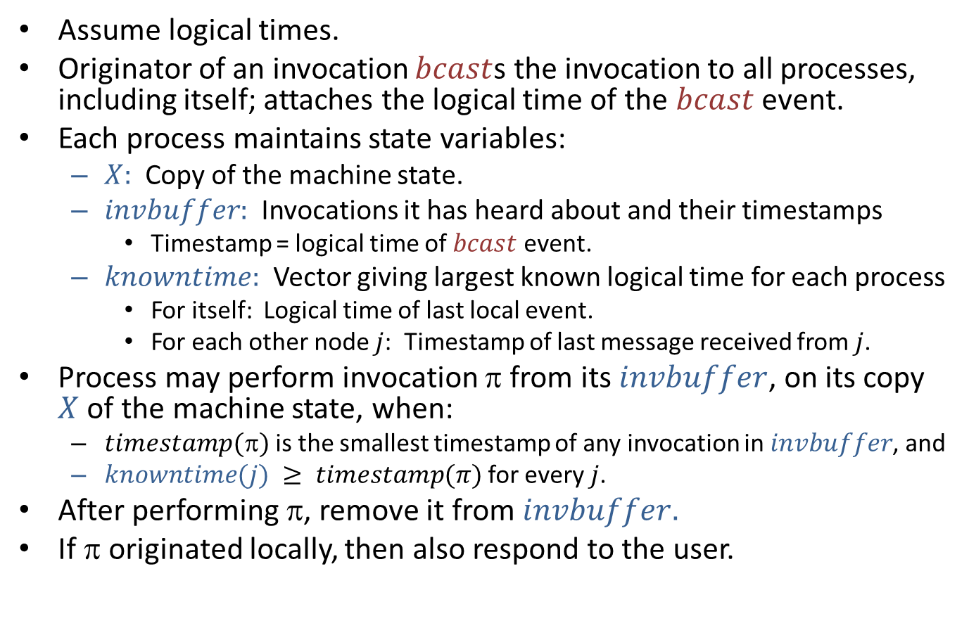
RSM algorithm
Assume logical times.
Originator of an invocation $bcast$s the invocation to all processes, including itself; attaches the logical time of the $bcast$ event.
Each process maintains state variables:
$X:$ Copy of the machine state.
$invbuffer:$ Invocations it has heard about and their timestamps
Timestamp = logical time of $bcast$ event.
$knowntime:$ Vector giving largest known logical time for each process
For itself: Logical time of last local event.
For each other node $j$: Timestamp of last message received from $j$.
Process may perform invocation π from its $invbuffer$, on its copy $X$ of the machine state, when:
$timestamp()$is the smallest timestamp of any invocation in $invbuffer$, and
$knowntime(j) ≥ timestamp(π)$for every $j$.
After performing π, remove it from $invbuffer.$
If π originated locally, then also respond to the user.
Notes:
We probably don’t need bcast here, could emulate this with point-to-point messages.

Slide 34
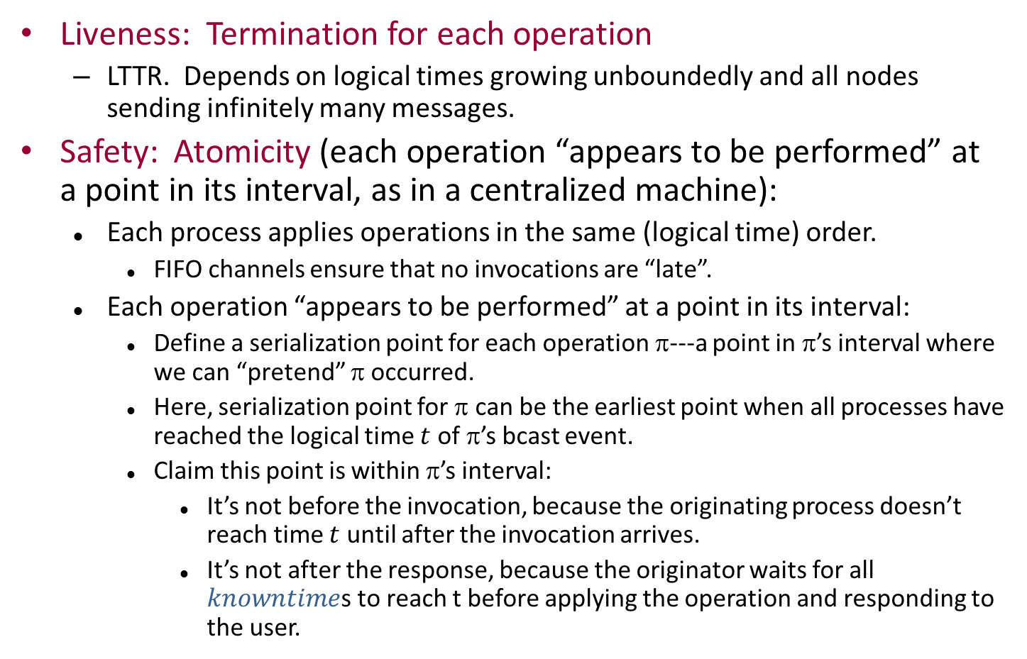
Correctness
Liveness: Termination for each operation
LTTR. Depends on logical times growing unboundedly and all nodes sending infinitely many messages.
Safety: Atomicity (each operation “appears to be performed” at a point in its interval, as in a centralized machine):
Each process applies operations in the same (logical time) order.
FIFO channels ensure that no invocations are “late”.
Each operation “appears to be performed” at a point in its interval:
Define a serialization point for each operation π---a point in π’s interval where we can “pretend” π occurred.
Here, serialization point for π can be the earliest point when all processes have reached the logical time $t$ of π’s bcast event.
Claim this point is within π’s interval:
It’s not before the invocation, because the originating process doesn’t reach time $t$ until after the invocation arrives.
It’s not after the response, because the originator waits for all $knowntime$s to reach t before applying the operation and responding to the user.
Notes:
Ties for placement of serialization point: Put the ser pts in order of ltimes.

Slide 35
Safety, cont’d
Safety: Atomicity (each operation “appears to be performed” at a point in its interval, as in a centralized machine):
Each process applies operations in the same (logical time) order.
Define serialization point for each operation π to be the earliest point when all processes have reached the logical time t of π’s bcast event.
This point is within π’s interval.
The order of the serialization points is the same as the logical time order, which is the same as the order in which the operations are performed on all copies.
So, responses are consistent with the order of serialization points.
That is, it looks to all the users as if the operations occurred at their serialization points---as in a centralized machine.
Notes:
We’ll come back to serialization points and atomic objects---those that look like centralized state machines.
In a couple of weeks.
This is probably a bit mysterious now.

Slide 36
Special handling of reads
Don't bcast---just perform them locally.
Now, doesn’t satisfy atomicity.
Satisfies weaker property, serializability.
Notes:
Could we process reads more simply?
This might be reasonable, but it weakens the guarantees.

Slide 37
No serialization points…
P₁
P₂
P₃
Ser.pt, where
everyone has
reached t
W₁,
ltime = t
Learns everyone has
reached t.
Performs W on its
local copy.
R₂
Performs R₂
locally.
Gets newly
written value.
Performs R₃
locally.
Gets old
value.
R₃
Learns everyone has
reached t.
Performs W on its
local copy.
Nowhere to put serialization
points for reads.
Notes:
Here is an example showing how we fail to get atomicity (behavior like that of a centralized state machine) when we perform writes as before but perform reads locally.
R2 completely follows R1, yet R1 gets the new value and R2 the old value.
This is not possible for a centralized state machine.
We can’t assign serialization points within the intervals in such a way that the operations appear to “occur at” these points.
Problems of asynchrony…

Slide 38
Application of RSM: Distributed mutual exclusion
Distributed mutual exclusion problem:
Users at different locations submit requests for a resource from time to time.
System grants requests, so that:
No two users get the resource at the same time, and
Every request is eventually granted.
Users must return the resource.
Can solve distributed mutual exclusion using a distributed simulation of a centralized state machine.
See book, p. 609-610.
U₂
U₁
U_{n}
grant,
ack
request,
return
Distributed system
solving mutual exclusion

Slide 39
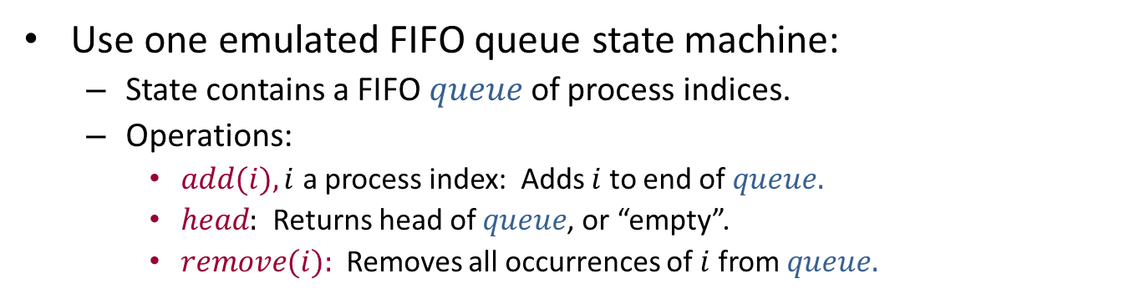
Distributed mutual exclusion
Use one emulated FIFO queue state machine:
State contains a FIFO $queue$ of process indices.
Operations:
$add(i), i$ a process index: Adds $i$ to end of $queue.$
$head:$ Returns head of $queue$, or “empty”.
$remove(i):$Removes all occurrences of $i$ from $queue.$
U₂
U₁
U_{n}
request,
return
M₂
M₁
M_{n}
add,
head,
remove
Emulation of FIFO queue
state machine

Slide 40
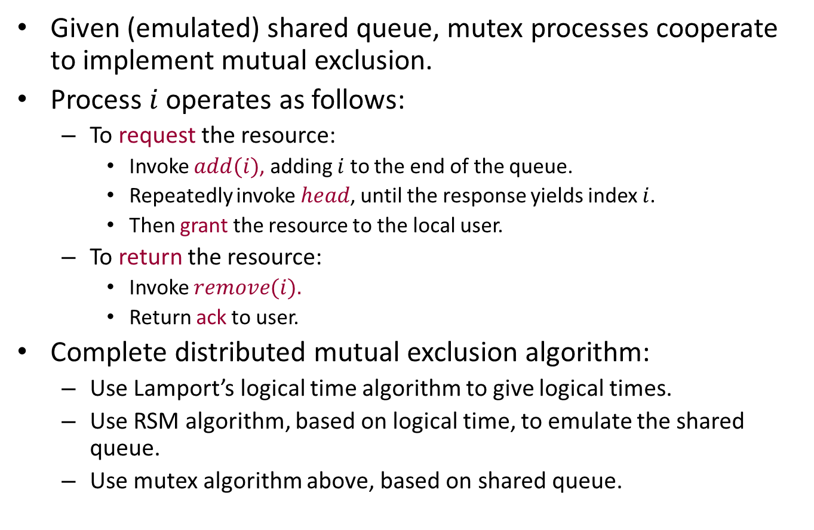
Distributed mutual exclusion
Given (emulated) shared queue, mutex processes cooperate to implement mutual exclusion.
Process $i$ operates as follows:
To request the resource:
Invoke $add(i)$, adding $i$ to the end of the queue.
Repeatedly invoke $head$, until the response yields index $i$.
Then grant the resource to the local user.
To return the resource:
Invoke $remove(i).$
Return ack to user.
Complete distributed mutual exclusion algorithm:
Use Lamport’s logical time algorithm to give logical times.
Use RSM algorithm, based on logical time, to emulate the shared queue.
Use mutex algorithm above, based on shared queue.

Slide 41
Weak Logical Time and Vector Timestamps

Slide 42
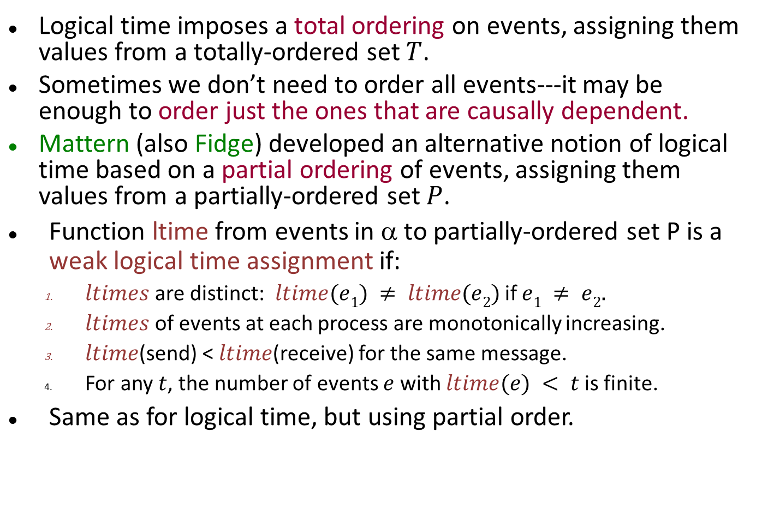
Weak Logical Time
Logical time imposes a total ordering on events, assigning them values from a totally-ordered set $T$.
Sometimes we don’t need to order all events---it may be enough to order just the ones that are causally dependent.
Mattern (also Fidge) developed an alternative notion of logical time based on a partial ordering of events, assigning them values from a partially-ordered set $P$.
Function ltime from events in α to partially-ordered set P is a weak logical time assignment if:
$ltimes$are distinct: $ltime(e1) ≠ ltime(e2)$if $e1 ≠ e2.$
$ltimes$ of events at each process are monotonically increasing.
$ltime$(send) < $ltime$(receive) for the same message.
For any $t$, the number of events $e$ with $ltime(e) < t$is finite.
Same as for logical time, but using partial order.

Slide 43
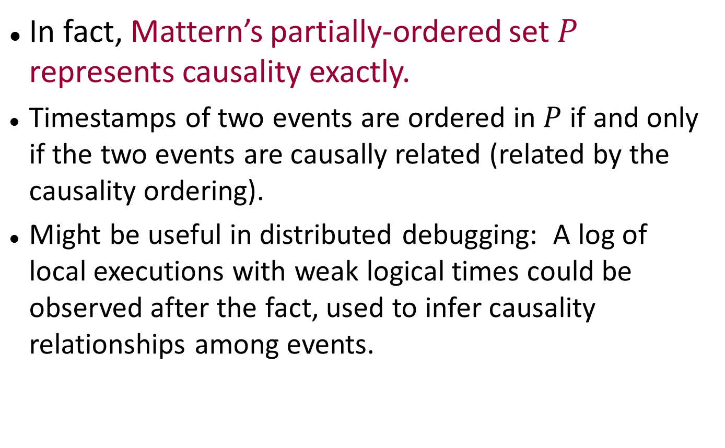
Weak Logical Time
In fact, Mattern’s partially-ordered set $P$ represents causality exactly.
Timestamps of two events are ordered in $P$ if and only if the two events are causally related (related by the causality ordering).
Might be useful in distributed debugging: A log of local executions with weak logical times could be observed after the fact, used to infer causality relationships among events.

Slide 44
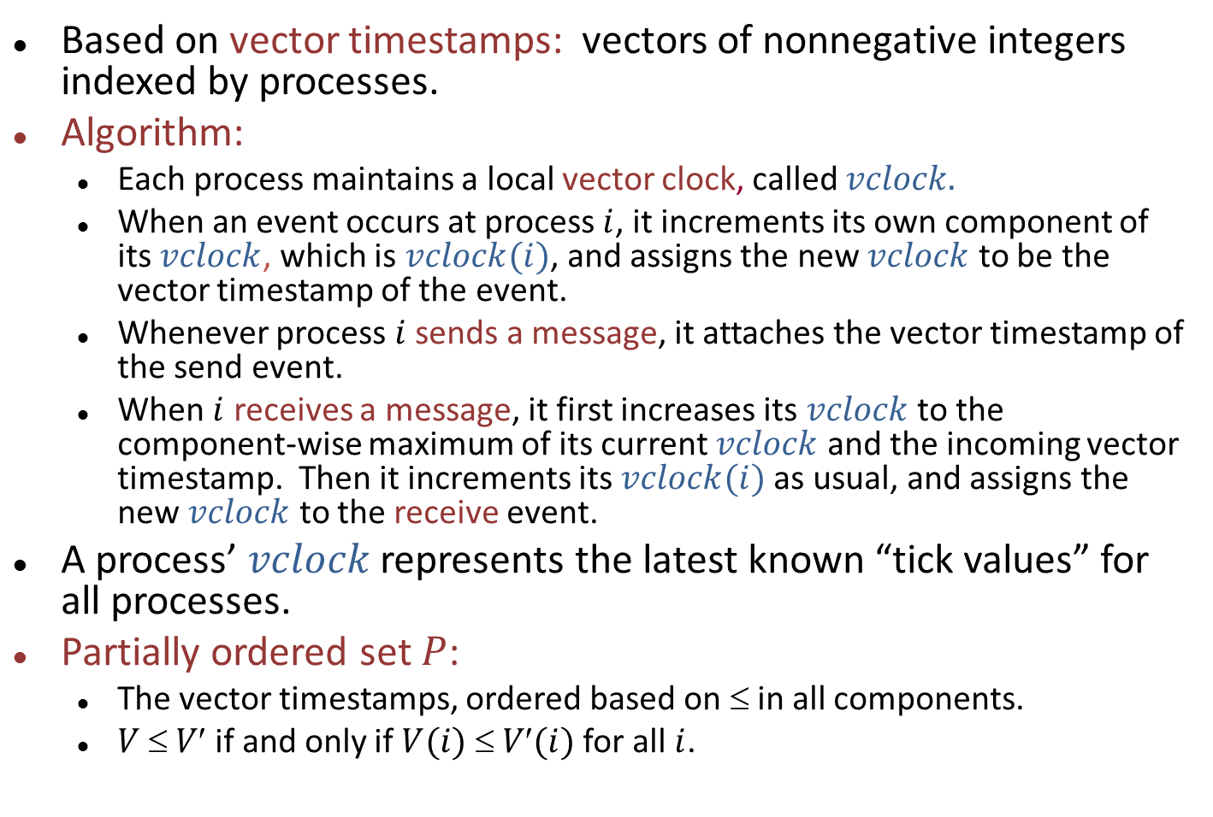
Algorithm for weak logical time
Based on vector timestamps: vectors of nonnegative integers indexed by processes.
Algorithm:
Each process maintains a local vector clock, called $vclock.$
When an event occurs at process $i$, it increments its own component of its $vclock$, which is $vclock(i)$, and assigns the new $vclock$ to be the vector timestamp of the event.
Whenever process $i$ sends a message, it attaches the vector timestamp of the send event.
When $i$ receives a message, it first increases its $vclock$ to the component-wise maximum of its current $vclock$ and the incoming vector timestamp. Then it increments its $vclock(i)$as usual, and assigns the new $vclock$ to the receive event.
A process’ $vclock$ represents the latest known “tick values” for all processes.
Partially ordered set $P$:
The vector timestamps, ordered based on ≤ in all components.
$V  V$if and only if $V(i)  V(i)$for all $i$.
Notes:
This is an algorithm to implement weak log. time.

Slide 45
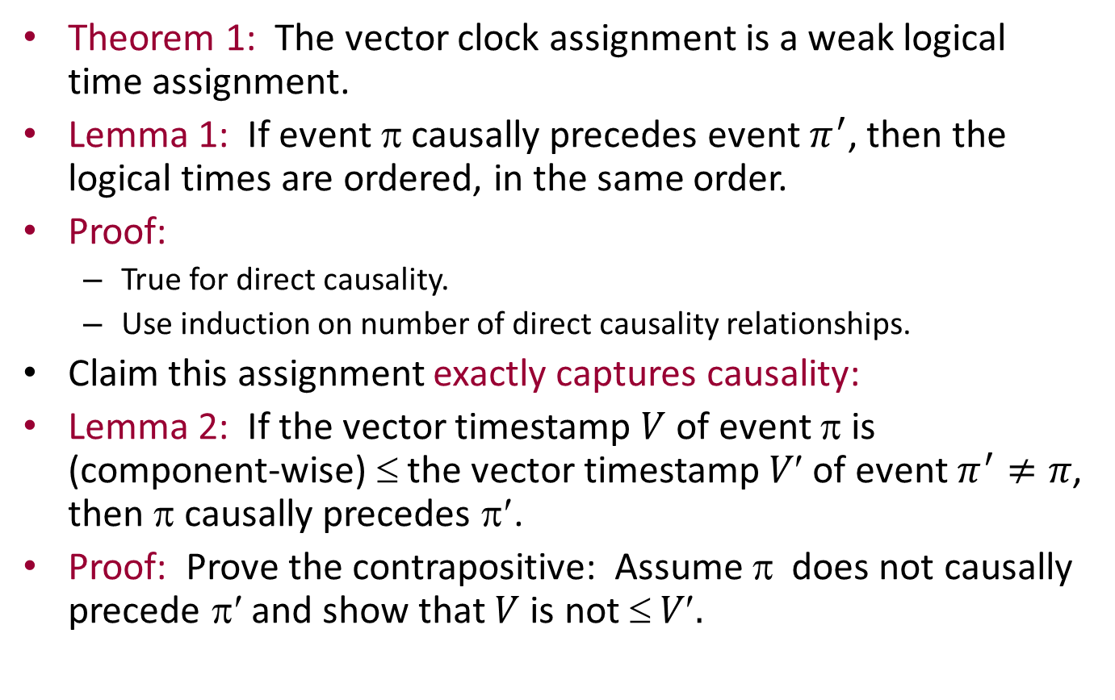
Key theorems about vector clocks
Theorem 1: The vector clock assignment is a weak logical time assignment.
Lemma 1: If event $$ causally precedes event $π^{′}$, then the logical times are ordered, in the same order.
Proof:
True for direct causality.
Use induction on number of direct causality relationships.
Claim this assignment exactly captures causality:
Lemma 2: If the vector timestamp $V$ of event π is (component-wise) ≤ the vector timestamp $V$ of event $π^{′}≠π$, then π causally precedes π′.
Proof: Prove the contrapositive: Assume $$ does not causally precede π′ and show that $V$is not $ V.$

Slide 46
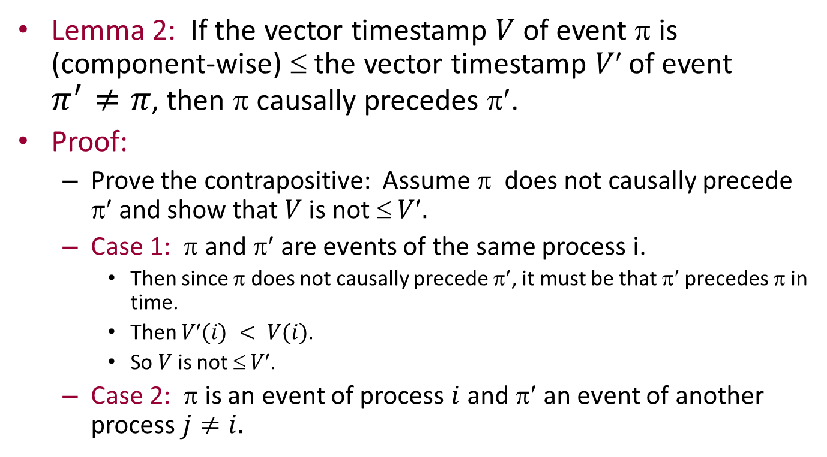
Proof of Lemma 2
Lemma 2: If the vector timestamp $V$of event π is (component-wise) ≤ the vector timestamp $V$ of event $π^{′}≠π$, then π causally precedes π′.
Proof:
Prove the contrapositive: Assume π does not causally precede π′ and show that $V$is not $ V.$
Case 1: π and π′ are events of the same process i.
Then since π does not causally precede π′, it must be that π′ precedes π in time.
Then $V(i) < V(i).$
So $V$is not $ V.$
Case 2: π is an event of process $i$ and π′ an event of another process $j≠i.$

Slide 47
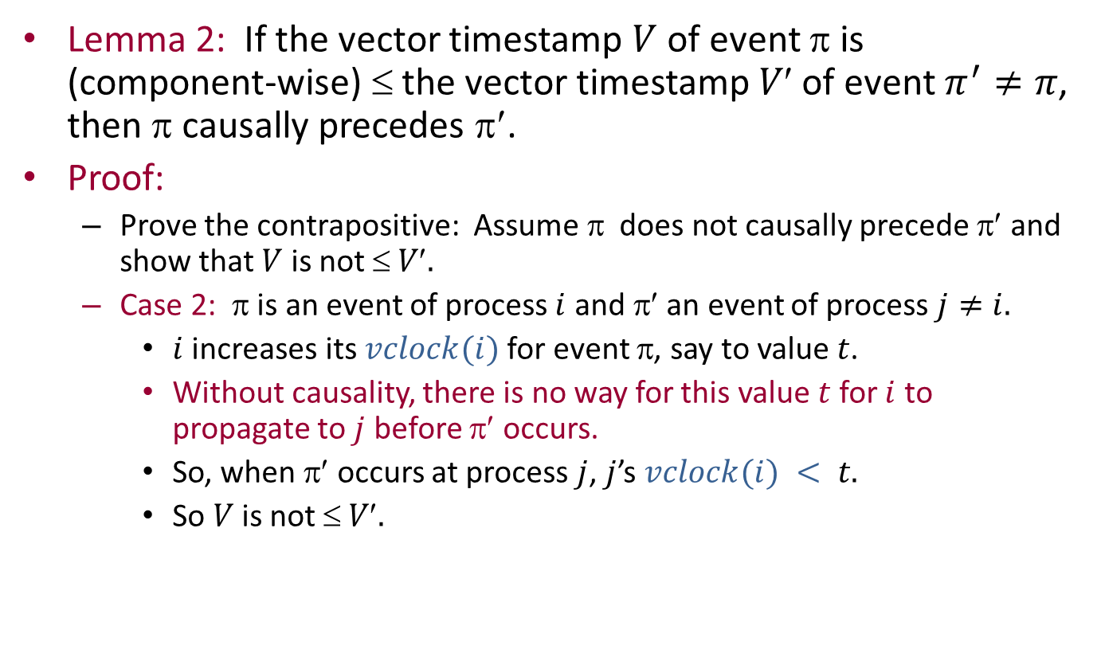
Proof of Lemma 2
Lemma 2: If the vector timestamp $V$ of event π is (component-wise) ≤ the vector timestamp $V$ of event $π^{′}≠π$, then π causally precedes π′.
Proof:
Prove the contrapositive: Assume π does not causally precede π′ and show that $V$ is not $ V.$
Case 2: π is an event of process $i$ and π′ an event of process $j≠i.$
$i$ increases its $vclock(i)$for event π, say to value $t$.
Without causality, there is no way for this value $t$ for $i$ to propagate to $j$ before π′ occurs.
So, when π′ occurs at process $j$, $j$’s $vclock(i) < t.$
So $V$ is not $ V.$

Slide 48
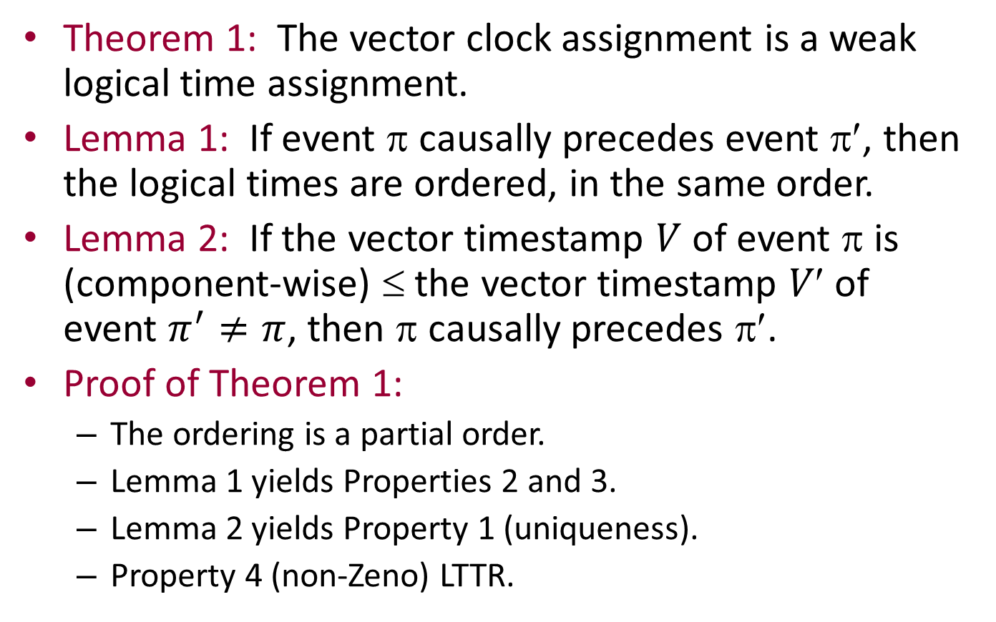
Back to Theorem 1
Theorem 1: The vector clock assignment is a weak logical time assignment.
Lemma 1: If event π causally precedes event π′, then the logical times are ordered, in the same order.
Lemma 2: If the vector timestamp $V$ of event π is (component-wise) ≤ the vector timestamp $V$ of event $π^{′}≠π$, then π causally precedes π′.
Proof of Theorem 1:
The ordering is a partial order.
Lemma 1 yields Properties 2 and 3.
Lemma 2 yields Property 1 (uniqueness).
Property 4 (non-Zeno) LTTR.
Notes:
For Property 1, suppose that two events have the same vector timestamp. Then each causally precedes the other, so they must be the same event.
Property 4 argument is like the one for Lamport time.

Slide 49
Another important theorem about vector timestamps [Mattern]
Relates timestamps to consistent cuts of the causality graph.
Cut: A point between events at each process.
Specify a cut by a vector giving the number of preceding steps at each location.
Consistent cut: “Closed under causality”: If event π causally precedes event π′ and π′ is before the cut, then so is π.
Example:
Consistent
cut
Not
consistent
Notes:
This inconsistent cut has a message whose receive precedes the cut but whose send follows the cut.

Slide 50
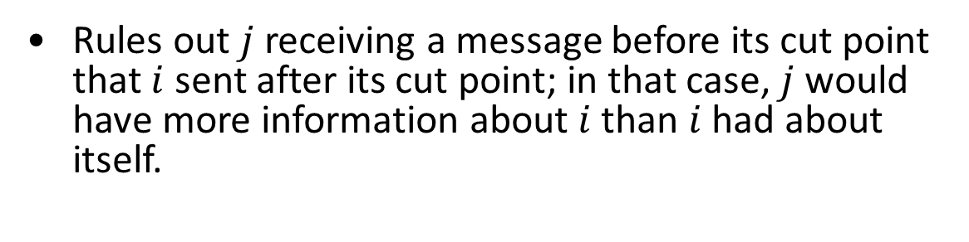
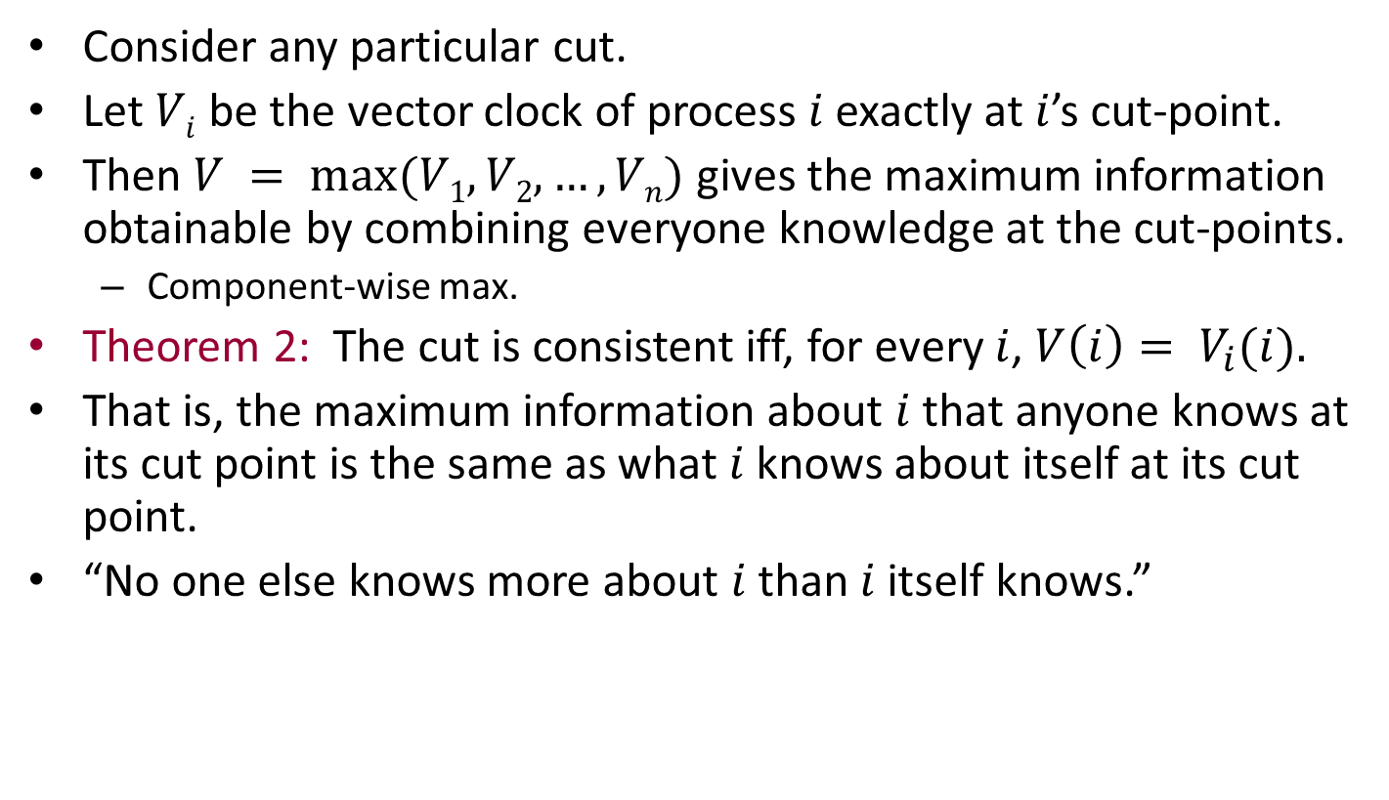
The theorem
Consider any particular cut.
Let $Vi$ be the vector clock of process $i$ exactly at $i$’s cut-point.
Then $V = max⁡(V1, V2,…,Vn)$gives the maximum information obtainable by combining everyone knowledge at the cut-points.
Component-wise max.
Theorem 2: The cut is consistent iff, for every $i$, $V\left(i\right)= V_{i}(i).$
That is, the maximum information about $i$ that anyone knows at its cut point is the same as what $i$ knows about itself at its cut point.
“No one else knows more about $i$ than $i$ itself knows.”
i
j
Rules out $j$ receiving a message before its cut point that $i$ sent after its cut point; in that case, $j$ would have more information about $i$than $i$ had about itself.

Slide 51
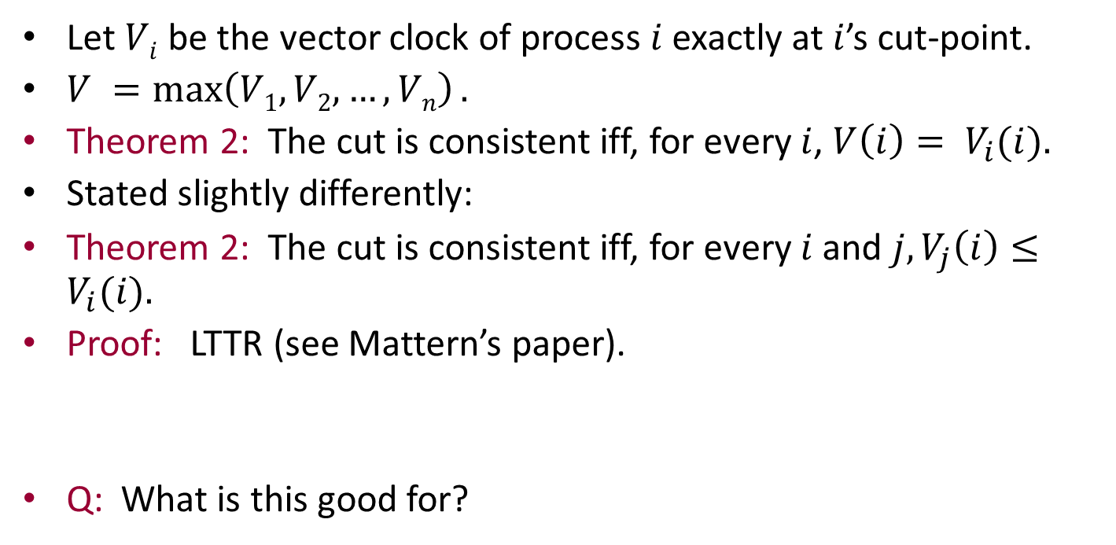
The theorem
Let $Vi$ be the vector clock of process $i$ exactly at $i$’s cut-point.
$V =\max\left(V1, V2,…,Vn\right).$
Theorem 2: The cut is consistent iff, for every $i$, $V\left(i\right)= V_{i}(i).$
Stated slightly differently:
Theorem 2: The cut is consistent iff, for every $i$and $j, V_{j}\left(i\right)≤V_{i}(i).$
Proof: LTTR (see Mattern’s paper).
Q: What is this good for?

Slide 52
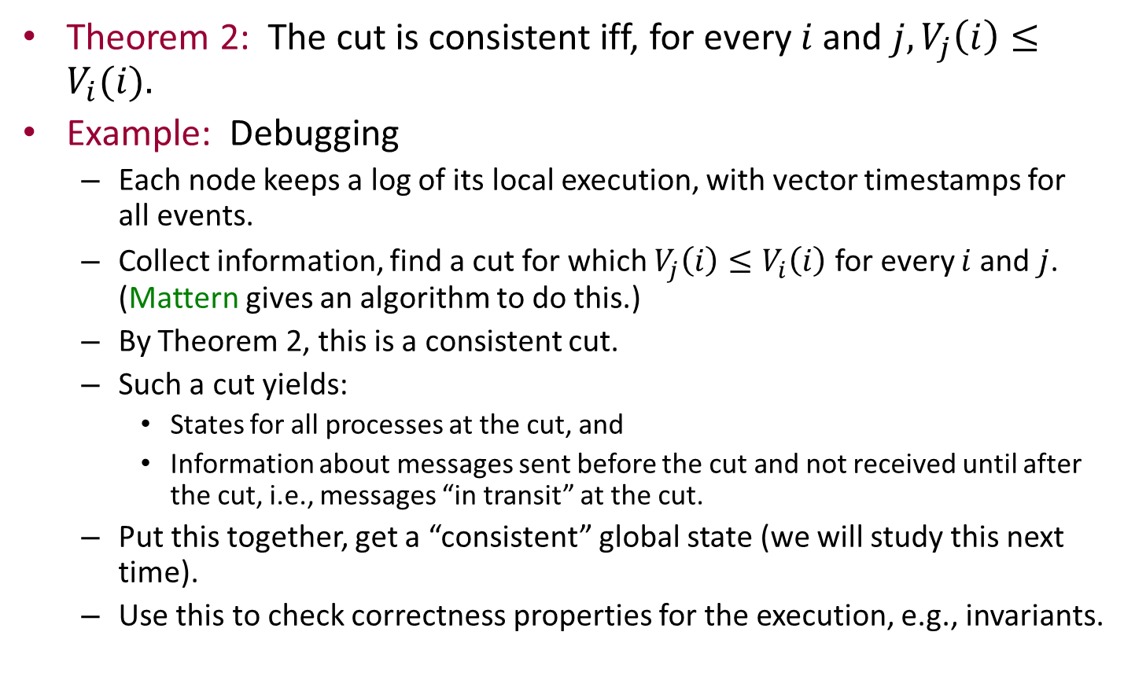
Application: Debugging
Theorem 2: The cut is consistent iff, for every $i$and $j, V_{j}\left(i\right)≤V_{i}(i).$
Example: Debugging
Each node keeps a log of its local execution, with vector timestamps for all events.
Collect information, find a cut for which $V_{j}\left(i\right)≤V_{i}\left(i\right)$for every $i$and $j$. (Mattern gives an algorithm to do this.)
By Theorem 2, this is a consistent cut.
Such a cut yields:
States for all processes at the cut, and
Information about messages sent before the cut and not received until after the cut, i.e., messages “in transit” at the cut.
Put this together, get a “consistent” global state (we will study this next time).
Use this to check correctness properties for the execution, e.g., invariants.

Slide 53
Next time
Consistent global snapshots
Stable property detection
Reading: Chapter 19

